Slide 1

‘Disadvantaged Community’/Equity Metrics
Hannah DeBruin
Weekly Meeting: Transit Data Subgroup
02/07/23

Slide 2
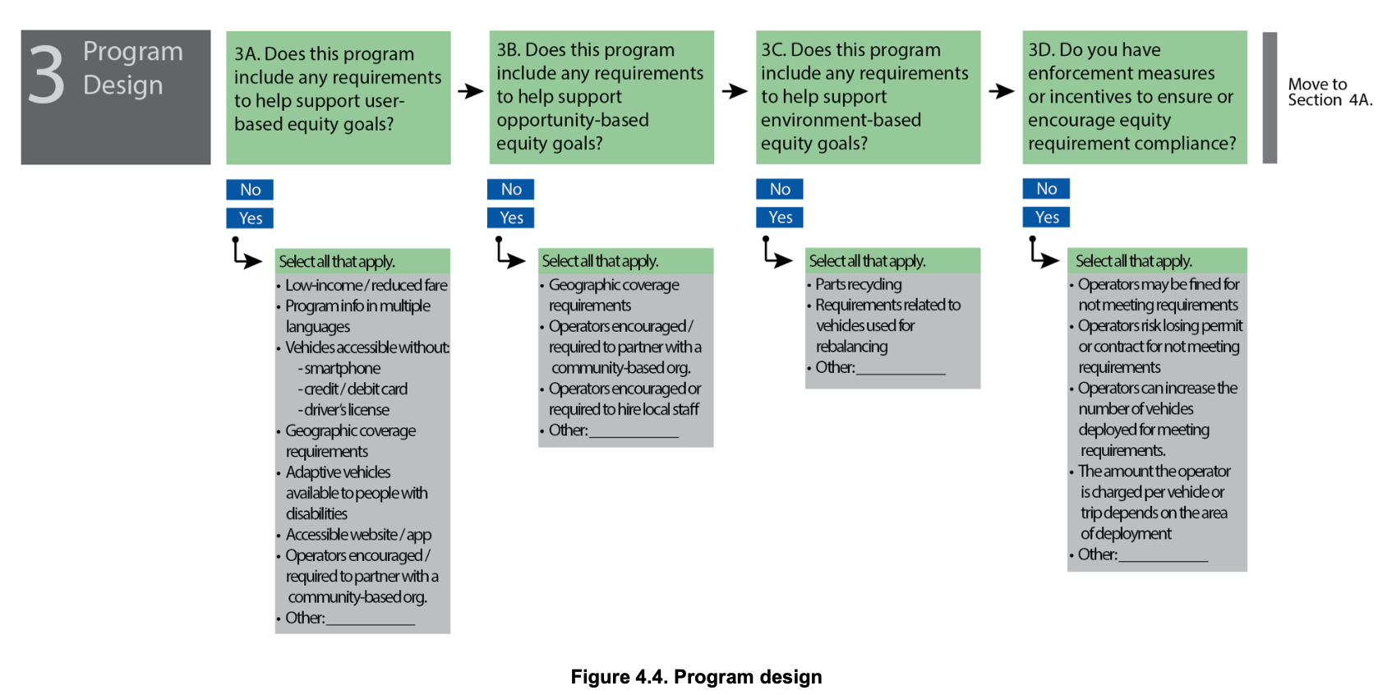


Micromobility Design Equity Goals
Weekly Meeting (02/07/2023)
Hannah DeBruin

Slide 3
What Cities Currently Require (Spatially)
CITY | SPATIAL EQUITY REQUIREMENT
Baltimore | No less than 5%, no more than 25% of fleet to each deployment district defined by the DOT and most deploy at least three vehicles in each equity zone
Denver | At least 30 percent of vehicles will be made available daily (at morning deployment) in communities ("opportunity areas") that have historically been underinvested in to increase their access to new transportation options, particularly focusing on areas with low vehicle ownership and high transit ridership.
Chicago | Licensees are required make scooters available to all residents of the city and the commissioner is authorized to create geographic areas for the purpose of requiring and implementing the equitable distribution of scooters.
Charleston | Contractor asked to describe their plan for ensuring bicycle access in equity zones defined by the city
Weekly Meeting (02/07/2023)
Hannah DeBruin

Slide 4
Minneapolis
In the process of updating their methodology for defining ‘Equity Distribution Areas’!
https://metrocouncil.org/Data-and-Maps/Research-and-Data/Place-based-Equity-Research.aspx
Currently, a minimum of 25 scooters are required to be distributed in identified ‘Equity Distribution Areas’, which were selected from ACP and ACP50 census tracts. This used to be 5%, but was changed because the EDAs were residential and scooters were underutilized
“Areas of Concentrated Poverty (ACPs) as census tracts where 40% of more of the residents have family or individual incomes that area less than 185% of the federal poverty threshold.”
“To identify areas where people of color experience the most exposure to concentrated poverty, the Council further differentiated Areas of Concentrated Poverty where 50% or more of the residents are people of color as ACP50s. “ – They are phasing this idea out
The new Equity Considerations dataset will only evaluate ACPs and new ‘Areas of Concentrated Affluence’ to better capture inequality throughout the Twin Cities. TBD on how spatial distribution requirements will be affected.
Weekly Meeting (02/07/2023)
Hannah DeBruin

Slide 5
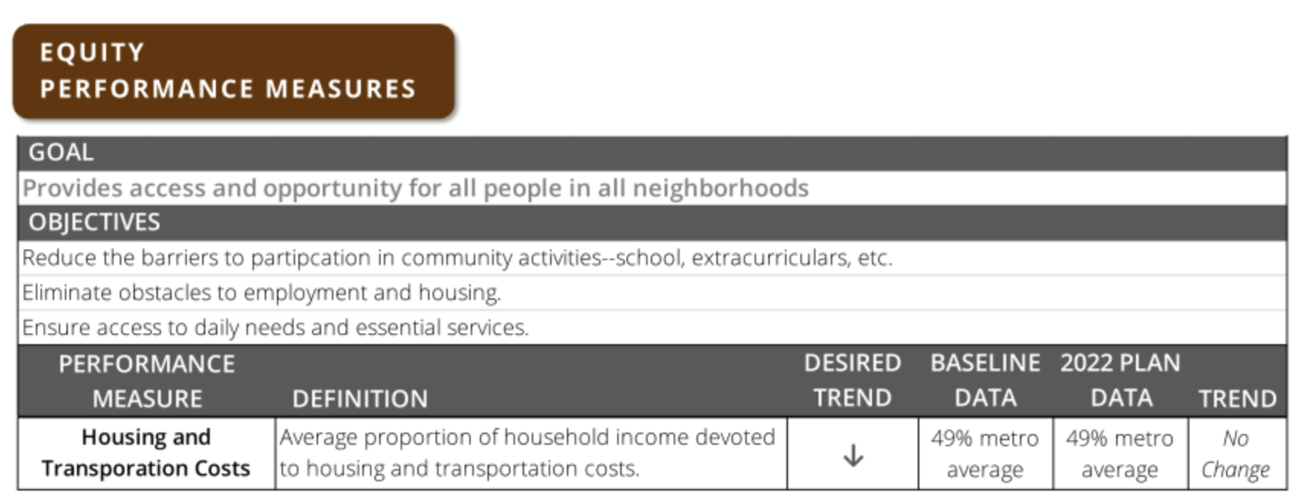

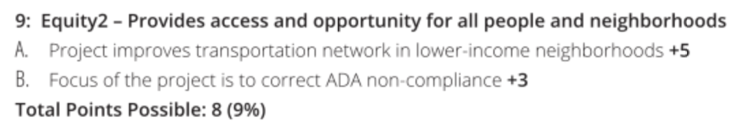
MPOJC
Project Scoring Criteria:
Weekly Meeting (02/07/2023)
Hannah DeBruin

Slide 6
General Takeaways from TRB “Micromobility, Bicycles, and the Future of Cities” Workshop and “Overview of Equity Performance Measures and Analysis” Panel
Move away from “who lives near this service” and towards “who benefits from this service” using access-to-opportunity metrics (quantifying potential destinations, ie jobs, or travel times to destinations
Various populations to consider that may have different needs/require different approaches for service
Low income households
Households without cars
Minorities
Seniors – often not spatially concentrated
Limited English Proficiency
Disability – often not spatially concentrated
Various benefits/metrics to consider that might require additional calculation/data collection:
Bike and pedestrian crash locations
Diesel Particulate Matter exposure
Job Accessibility
Affordability/Cost of Living (ie transportation burden or housing burden)
ACS Census Tract Data is one helpful/reliable data source, but don’t discount qualitative data
Some metrics use quantifiable data for certain equitable policies or outcomes, others have staff subjectively evaluate policies or outcomes
Weekly Meeting (02/07/2023)
Hannah DeBruin

Slide 7
Proposed Equity Metrics
IDed “communities of concern” census tracts (with ACS data) by regional planning commission factors and concentration thresholds (different combinations defined to be considered a CoC)
Minority – 70%
low income (<200% federal poverty level) – 30%
Limited English Proficiency – 20%
Zero-vehicle households -10%
Seniors 75+ - 10%
Disability – 25%
Single Parent Family – 20%
Severely rent-burdened – 15%
Different combinations of thresholds were evaluated
Service areas calculated as a quarter mile buffer around station, census tract data in that service area was averaged (weighted by population)
”Enhancing equitable service level: Which can address better, dockless or dock-based Bikeshare systems?”
San Francisco
Xiaodong Qian, Miguel Jallerb, Debbie Niemeier
Weekly Meeting (02/07/2023)
Hannah DeBruin

Slide 8
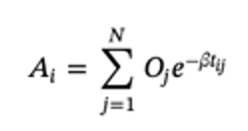
Proposed Equity Metrics
Disadvantaged census tracts =
Median household income
% minority population (High, moderate, low thresholds)
% households owning 0-1 vehicles (High, moderate, low thresholds)
Accessibility Improvement Metric:
Jobs data from LEHD database
Low-wage jobs ($3333/month or less)
Transit stations
Grocery stores
Hospitals
Schools
Used google maps API for two scenarios: walking and transit only, then assuming immediate access to bikeshare. Calculated travel times using standard walking, biking speeds and GTFS data from center of one census tract to another
Improvement in accessibility reported (high, moderate, and low).
Level of bikeshare infrastructure also evaluated Low, Moderate, High
All potential combinations of High, Moderate, Low inputs were categorized and assigned priority level
“High impact prioritization of bikeshare program investment to improve disadvantaged communities' access to jobs and essential services”
Chicago, Philadelphia
Xiaodong Qian, Deb Niemeier
Weekly Meeting (02/07/2023)
Hannah DeBruin

Slide 9
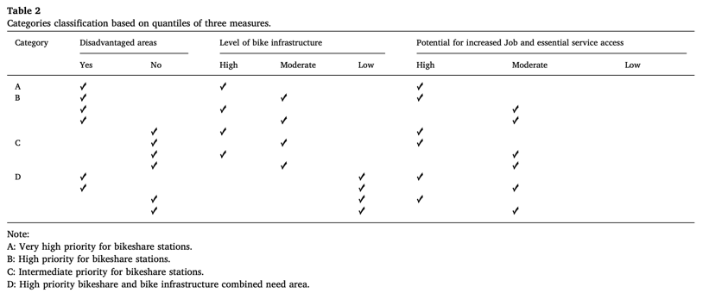
Proposed Equity Metrics
“High impact prioritization of bikeshare program investment to improve disadvantaged communities' access to jobs and essential services”
Chicago, Philadelphia
Xiaodong Qian, Deb Niemeier
Weekly Meeting (02/07/2023)
Hannah DeBruin

Slide 10
Proposed Equity Metrics
“Spatial Equity of Micromobility Systems: A Comparison of Shared E-scooters and
Docked Bikeshare in Washington DC”
Washington DC
Lin Su, Xiang Yan, Xilei Zhao, Ph.D. (unpublished)
“Equity Emphasis Area” status determined by income levels, racial and ethnic compositions as determined by National Capital Region Transportation Planning Board
Quartiles of household median income, identified as “low income” as bottom quartile, ”middle income”, and “high income” as top quartile
More than 50% residents of a specific single race as “X-majority” block groups, otherwise “No Majority”
LEHD O-D Employment Statistics aggregated to the block group level were used to calculate Accessibility, measured by kernel density (predefined search radius distance, highest values on top of the bike station, smooth curve as approaching search radius, averaged across block groups)
Vehicle availability and accessibility compared among “X-majority” and ”income level” block groups
Weekly Meeting (02/07/2023)
Hannah DeBruin

Slide 11
What I Intend to Do
ACS data to determine whether or not census tract should be considered an “equity zone”
Median household income level (bottom quartile of tracts)
Percent households without a vehicle (if this is greater than 10%)
(MAYBE) percent minority population – in Iowa City this might not make much of a difference anyway
LEHD data for job, grocery store, hospitals, schools to calculate accessibility like “High Impact Prioritization” study
By center of census tract, comparing just transit/walking to transit/walking/cycling time
Will have to determine GIS tool/Google Maps API for travel time calculations
For identified “equity zone” census tracts, the change in accessibility will be used as the weight of the equity input
greatly improved accessibility for equity zones = ten points, no improvement = one point
Weekly Meeting (02/07/2023)
Hannah DeBruin

